Slide 1


INCIDENT RESPONSE
H
CKNEY

Slide 2

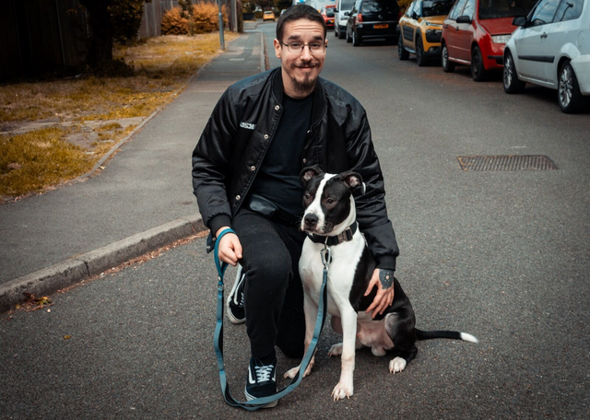

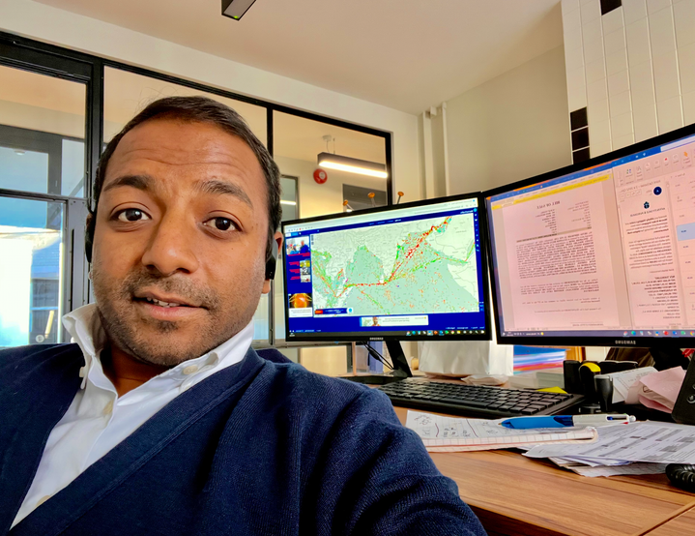

H
CKNEY
Leo Correia
Komala Hiremath
Shirantha Malighaspe
Sophie Watkinson
H
CKNEY

Slide 3
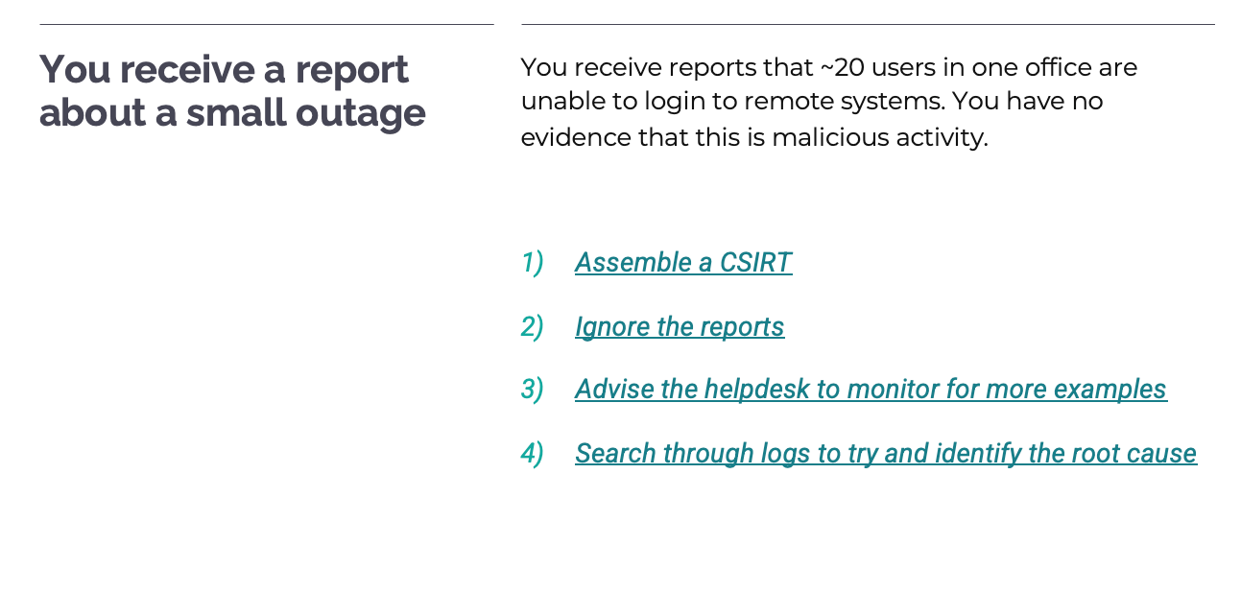
As a team, we have chosen “Advise the helpdesk to monitor for more examples” because there is no evidence of malicious activity. To assemble a CSIRT is a bit dramatic as this stage, we don’t ignore reports, and why would you spend hours of wasted time trawling through logs with no guarantee of finding anything.

Slide 4
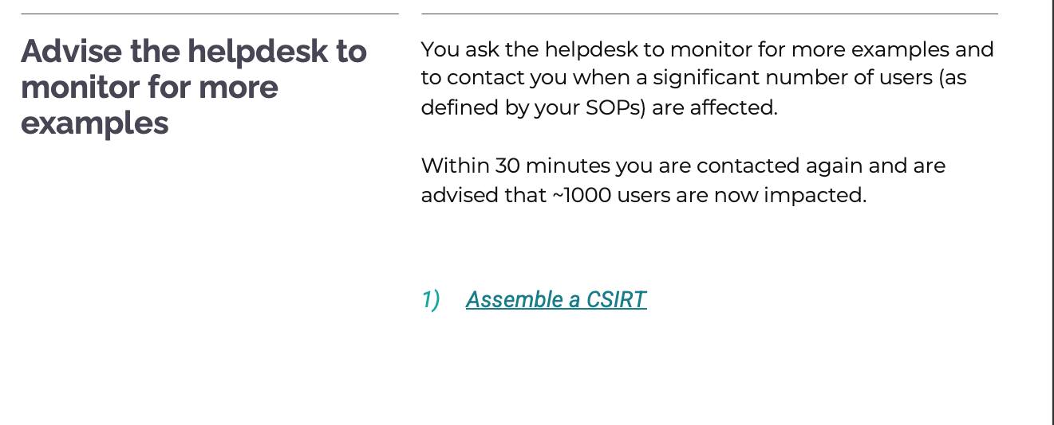
Assemble the CSIRT is the only valid option as we have more reports of users impacted, which needs to be escalated.

Slide 5
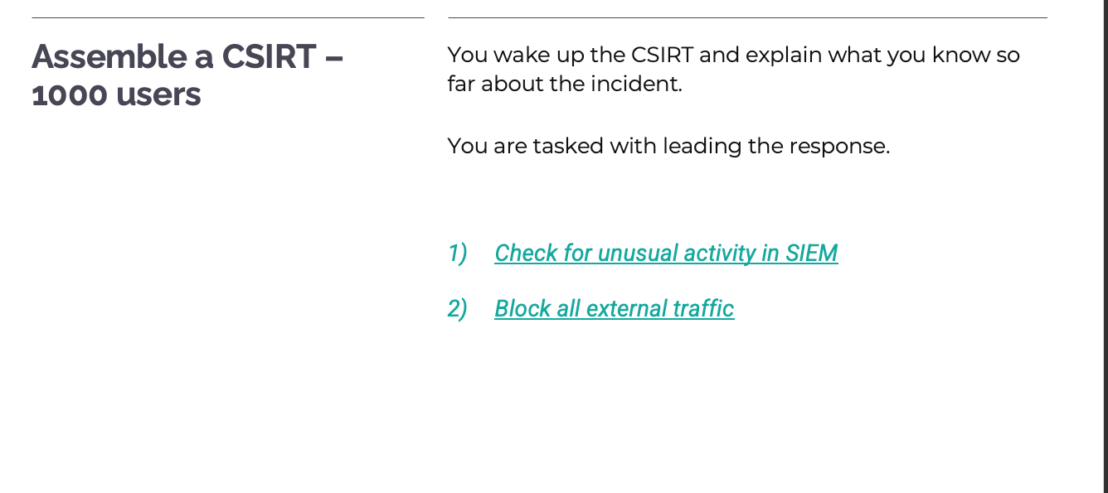
We have decided to use a SIEM to detect the malicious activity as it collects all logs of end point detection/WAF into a centralised dashboard.

Slide 6
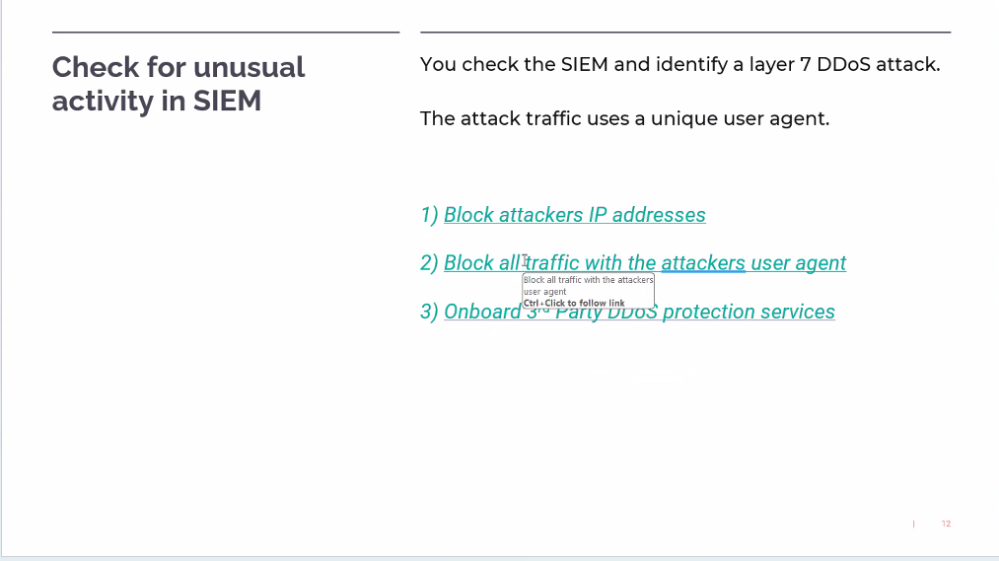
WAF monitors the application layer. We have chosen to block all traffic with the attackers user agent because the IP addresses are able to change frequently, meaning our mitigations are useless in this scenario. Onboarding a 3rd party is costly and will take weeks to implement.
An Attacker User Agent is a distinctive User-Agent HTTP header string sent to perform malicious activities. Attackers will often manipulate this string to blend in with legitimate traffic or to evade detection by security systems.

Slide 7
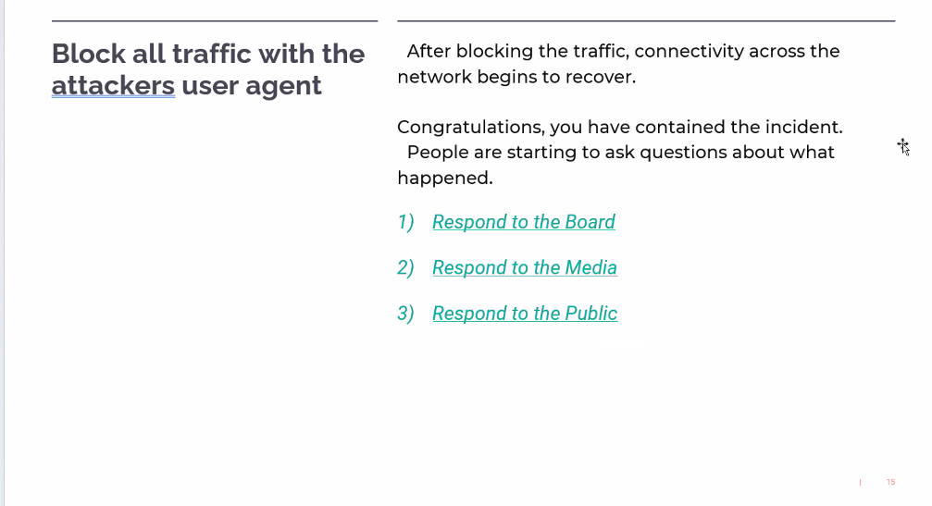
We have chosen to Respond to the Board, as we need to liaise with stakeholders and senior management before anyone else.
We do not respond to media or public unless we have a board approved statement.

Slide 8
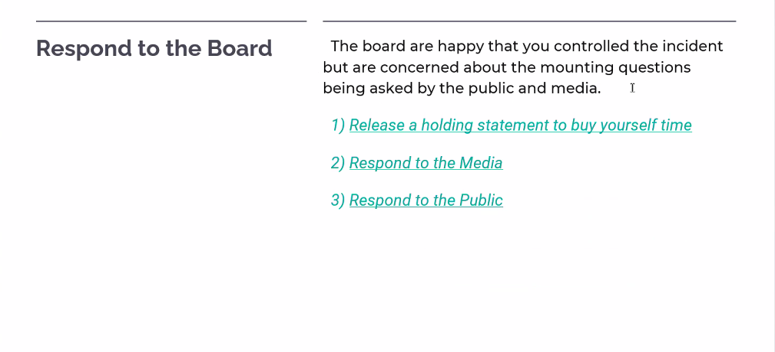
We have chosen to Release a Holding Statement to buy ourselves some time, because the media and public will have difficult questions, but a holding statement is reassuring that we have things under control while we continue to figure things out.

Slide 9
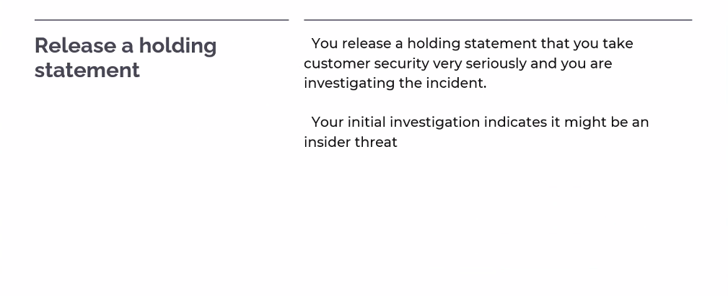
The investigation has shown it is an insider threat and the crisis is averted for now. The media and the public have factual information and no one can spread damaging rumours.

Slide 10
THANK YOU FOR YOUR ATTENTION
Get In Touch With Us
H
CKNEY

